Slide 1
Silent Scream

Slide 2
Effects of Bullying
Bullying can affect everyone—those who are bullied, those who bully, and those who witness bullying. Bullying is linked to many negative outcomes including impacts on mental health, substance use, and suicide. It is important to talk to pupils and students! Make them aware.
We try to do it in our school!

Slide 3
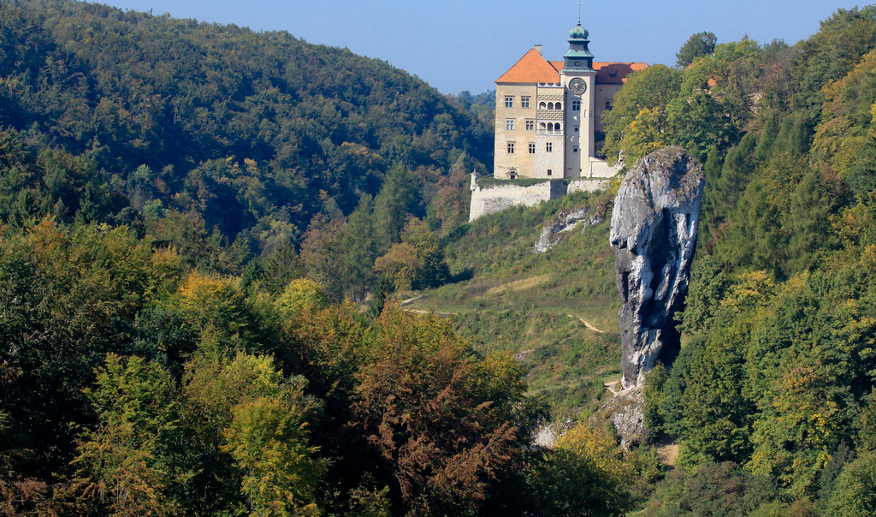
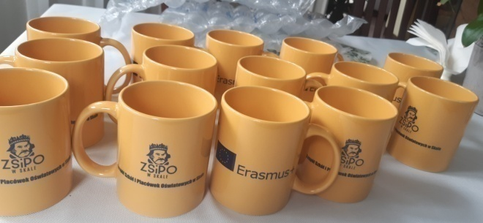
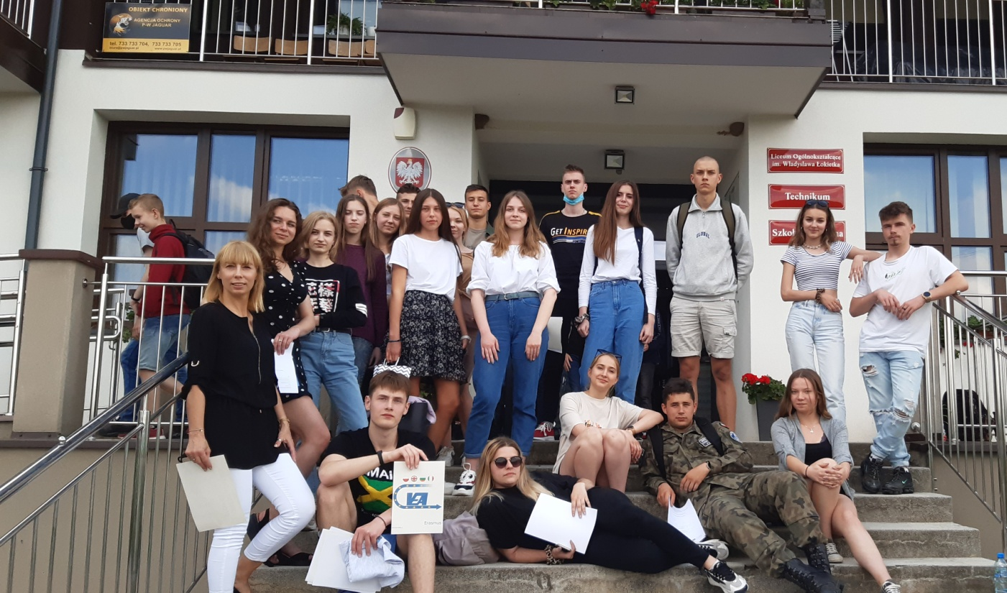
Some information about us
Our school is located near the Ojców National Park
In the Krakow poviat
Skała district
Lesser Poland area
The school is situated away from the city in a rural area
The Skała town is small and has a population of about 3800 people
we have about 400 students in the school ( from Poland, some from Ukraine Moldavia, Belarus)

Slide 4
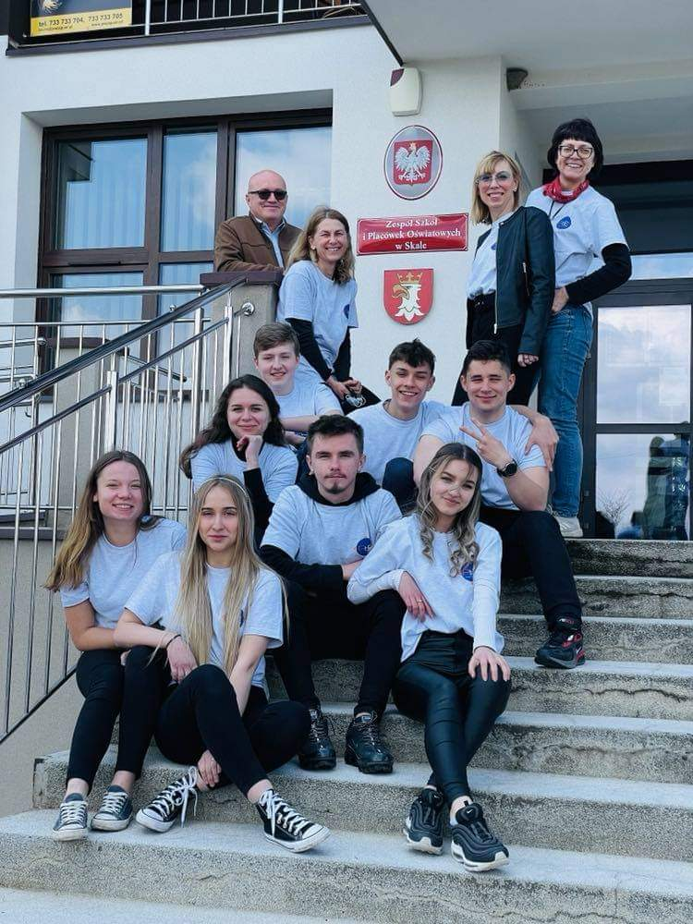
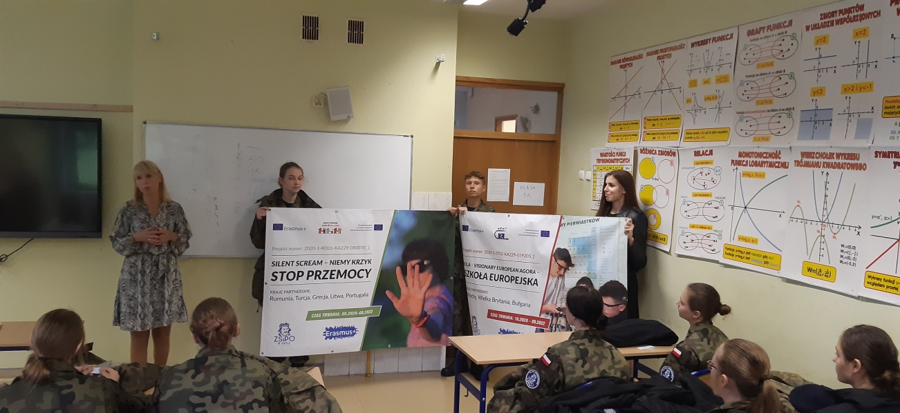
EU BLUE CARD In our country it is possible to have an EU BLUE CARD (The Blue Card is a procedure aimed at ensuring the safety of the person against whom domestic violence is used) 27 people are entitled to the blue card in the city of Skała

Slide 5
The scale of the problem of bullying in our school
Last year in our school, 46 students took the questionnaire abou bullying. The results showed that 58% of the students have been bullied in their lives.
The main forms of bullying; making fun of apperance; hurtful comments; online harassment.
The main reason: students crave attention of other students! They show off!
Other reasons; bordom and immaturity

Slide 6
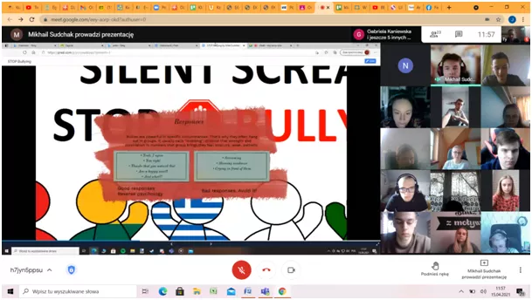
Examples of what my friends told me
„My friend was laughed at because she had a boyfriend 2 years older than her. Nobody wanted to be friends with her”
„my friend had problems at home, he had no money, he used drugs, he attempted suicide. Colleagues laughed at him, he was harassed, unpleasant comments”
„classmates used unpleasant commentators to my friend because she is short and slim”

Slide 7
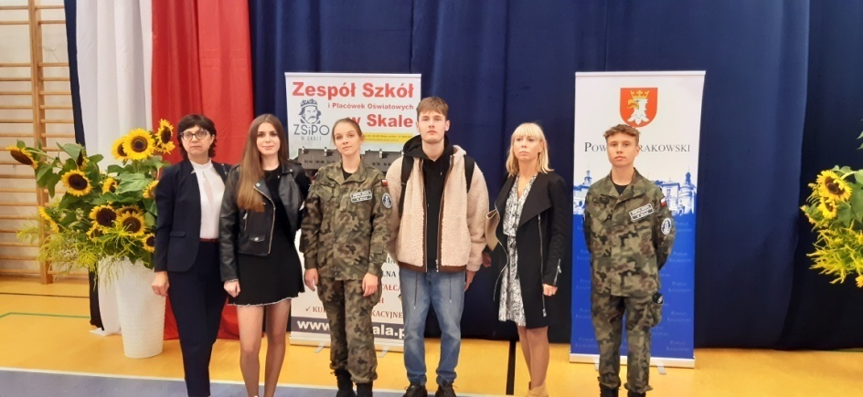
Progress at school- bullying happens less often
I think the scale of bullying at school is decreasing, because our whole community is working together
we have a psychologist and a pedagogist at school
we have a statute and regulations at school that we must obey
we get negative and positive comments and points from teachers for bad and good behavior
teachers keep order and are on constant duty during breaks at school
teachers fight with students’ bad habits at school,
such as smoking, harrassment, improper remarks

Slide 8
Thank you for your attention
Polish Team from ZSiPO in SKAłA

